Slide 1







Using Statistical and Machine Learning Models with Remotely Sensed Data to Estimate PM_{2.5} in the San Francisco Bay Area
NASA OSTEM Symposium 2020
Anna Boser¹
Mentors: Mohammad Al-Hamdan², Christian White²
¹Bren School of Environmental Science and Management, University of California Santa Barbara
²Universities Space Research Association, NASA Marshall Space Flight Center, Hunville, AL
Notes:
Say:
“This was an internship at NASA Marshall Space Flight Center with Center for Applied Atmospheric Research and Education (CAARE) program that is led by SJSU and funded by the NASA MIRO program.”

Slide 2
Outline
Research project presentation (~15 minutes)
My CAARE internship experience
Q&A (10-15 minutes)

Slide 3
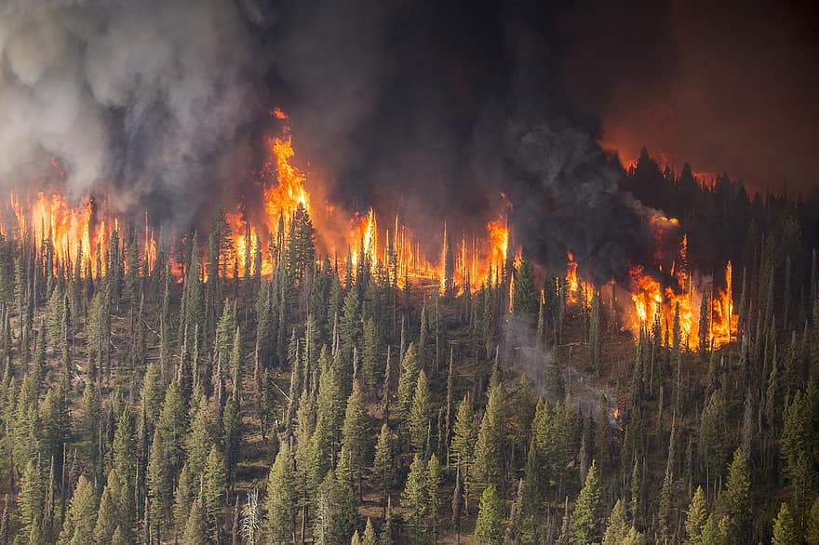
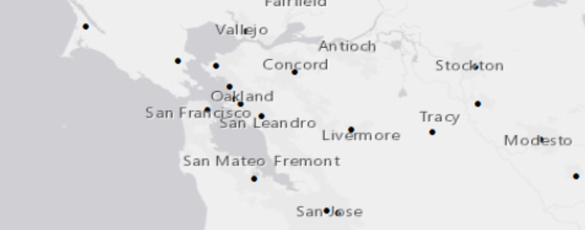
Motivation: PM_{2.5} in California
Ambient fine particulate matter (PM_{2.5}) is associated with significant adverse health impacts, including acute respiratory and cardiovascular illness.¹
In California, this is of particular concern because catastrophic wildfires cause episodes of very high levels of PM_{2.5}.²
PM_{2.5} monitors are few and unevenly distributed over the landscape.
Continuous, high resolution PM_{2.5} data has the potential to be greatly useful in public health research and mitigation efforts.

Slide 4
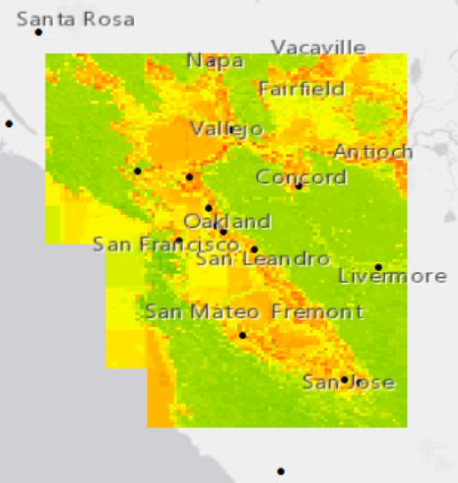
Goal
Create an accurate and high resolution (1km²) dataset of PM_{2.5} estimates that covers the San Francisco Bay Area by training and comparing comprehensive machine learning and statistical models using pertinent parameters.

Slide 5

Previous work
Previous studies have attempted to use various parameters and methods to estimate PM_{2.5} levels in many parts of the world.
Predictors: Meteorological, land cover/land use (LCLU), Emissions, and aerosol optical depth (AOD) data have all proven to be effective.³
Models: Statistical and machine learning (ML) models have been used. Certain ML methods have been shown to perform better when predicting extreme values, which is important in a public health context.⁴
In California:
A statistical two-stage model adopting a wide range or parameters has proven effective at a 1 km² resolution in southern California.⁵
Covering all of California, a 3 km² daily geo-statistical estimate grid built by Al-Hamdan et. al. which uses AOD is available from 2006-Present.⁶
Also over all of California, Gupta et. al. used AOD to create a statistical geographically weighted regression over a 10 km² grid for October 2017.⁷

Slide 6

Unanswered questions
Which statistical and machine learning models are most adapted to accurately estimate PM_{2.5} in the San Francisco Bay Area?
Will incorporating a wide range of parameters (Aerosol Optical Depth, Meterological, Land Cover/Land Use, Emissions) lead to accurate PM_{2.5} estimates?
Notes:
Certain machine learning methods have been shown to perform better when predicting extreme values, which is important in a public health context.

Slide 7
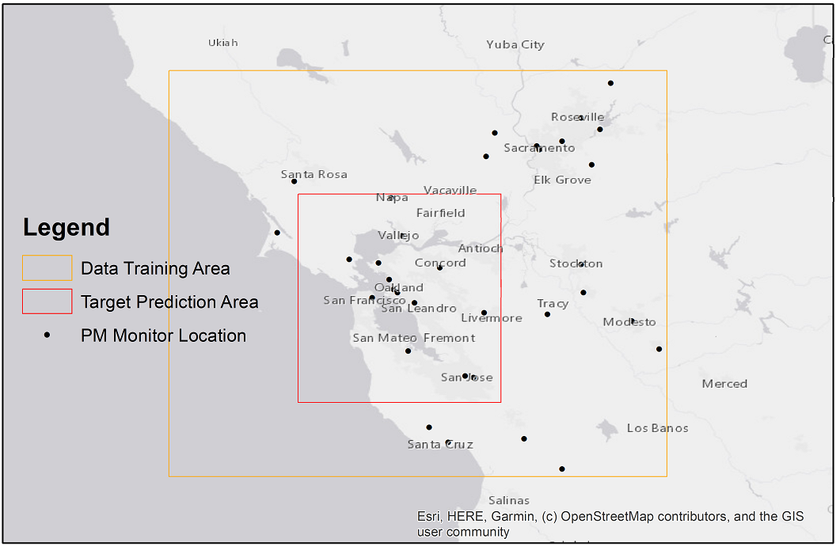
Site
San Francisco Bay Area
34 monitors for training, 14 in the target prediction area
327 days in 2017
(full year not used due to data constraints)

Slide 8
Methodology Flowchart
AOD Data (NASA MAIAC, NOAA HMS)
Meteorological Data (NLDAS, HRRR)
Two-stage (statistical) model development
Model evaluation, comparison, and selection (cross-validation)
Resample to 1 km² grid
PM_{2.5} estimate grid creation
LCLU Data (NLCD, TIGER,USGS NED)
Various machine learning model development
Emissions Data (EPA NEI)
PM_{2.5} concentration (EPA AQS)

Slide 9

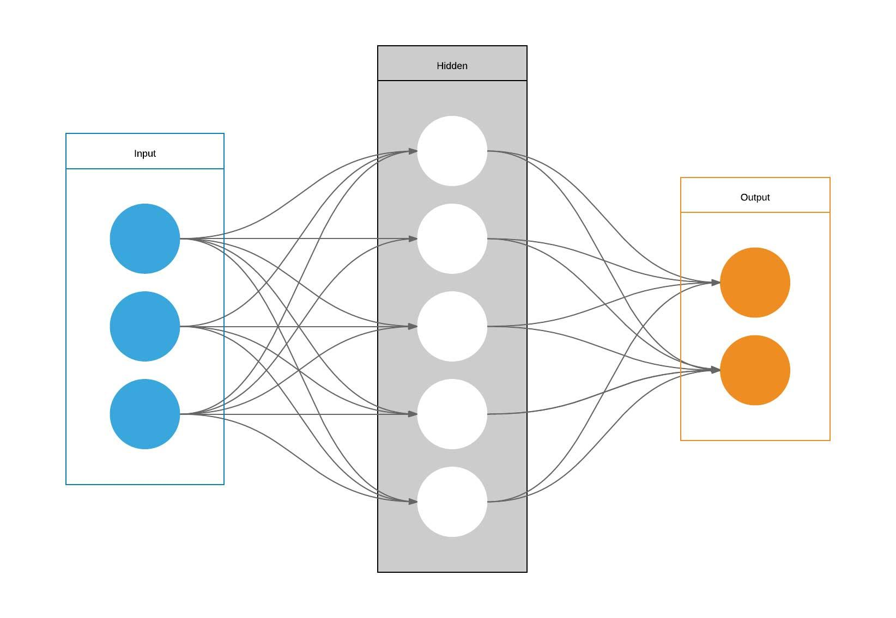
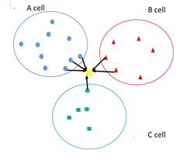
Models
Variables
Statistical two-stage model.
Stage 1: linear mixed effects model with random effect “Day.”
Stage 2: geographically weighted regression on aerosol optical depth.
Random forests and decision trees. Popular python libraries were used.
CatBoost boosted trees
LightGBM boosted trees (regular and custom)
Scikit learn random forest classifier
Scikit learn extremely randomized trees
Artificial Neural Networks.
Autogluon tabular deep neural networks (with and without tuning)
K Nearest Neighbors.
Scikit learn nearest neighbors (uniform and distance weighted)
LME
GWR
PM_{2.5}

Slide 10
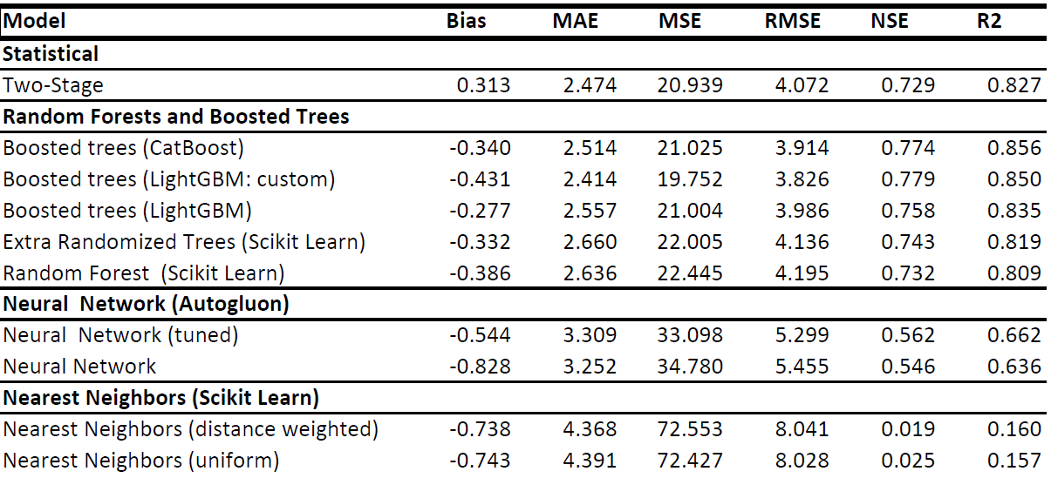
Model comparison overview

Slide 11
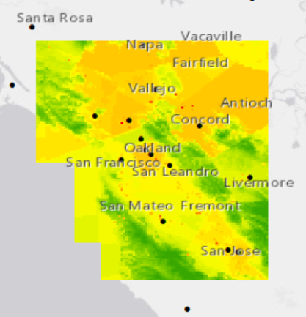
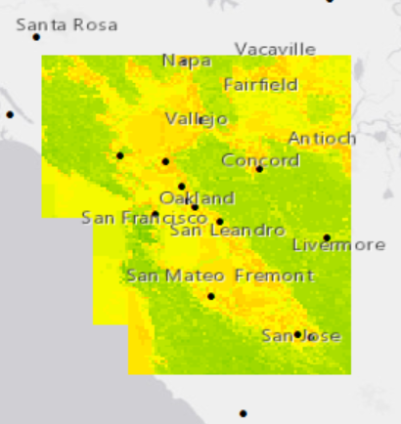
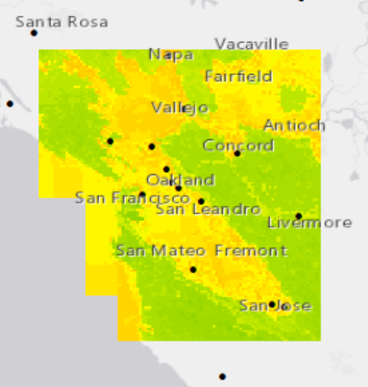
Model averages (µg/m³)
Two-Stage. Min: -3.3. Max: 352. Median: 8.3. Mean: 7.9. | CatBoost. Min: 3.6. Max: 13.1. Median: 7.2. Mean: 7.3. | LightGBM. Min: 4.5. Max: 12.2. Median: 7.3. Mean: 7.5.
0 or less
7
30
200 or more
0 or less
7
30
200 or more
0 or less
7
30
200 or more
Notes:
Explain why not capped at zero

Slide 12
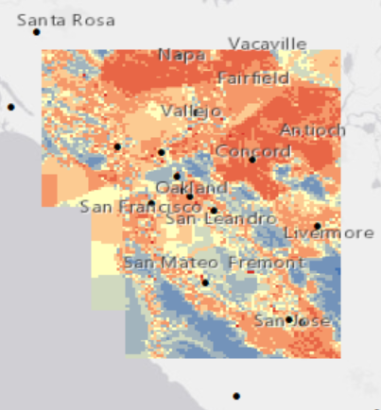
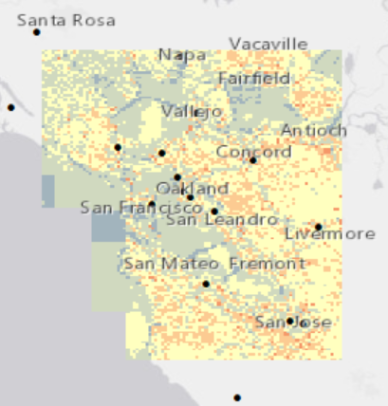
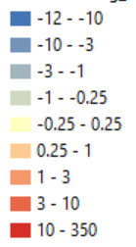
Model average differences
Two-Stage - CatBoost | CatBoost - LightGBM
Difference in PM_{2.5} estimates, in µg/m³

Slide 13
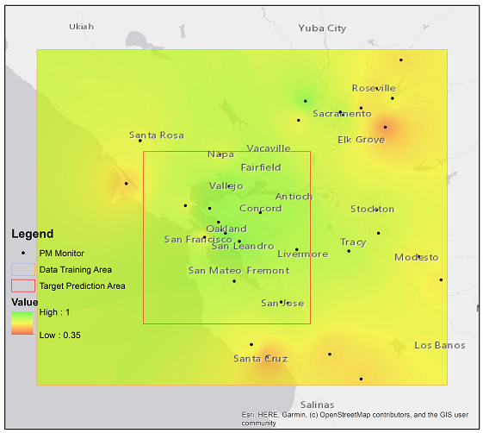
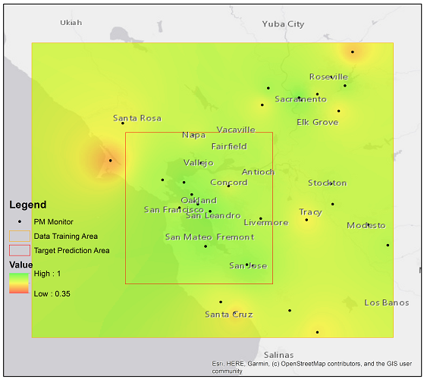
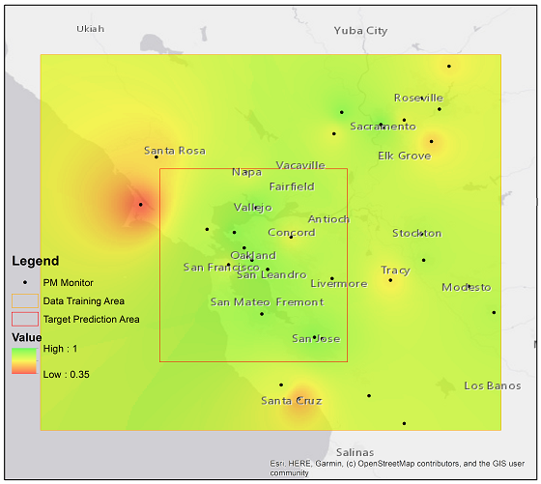
Interpolated Cross-Validated R² Values Over Entire Training Area
Two-Stage | CatBoost | LightGBM

Slide 14
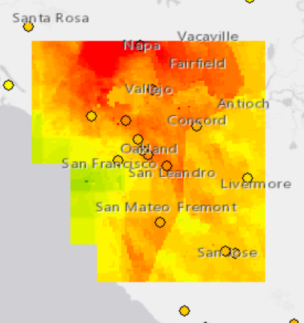
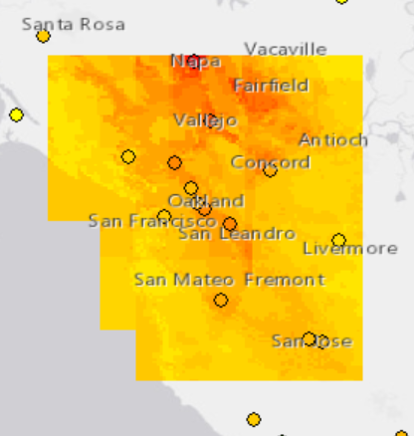
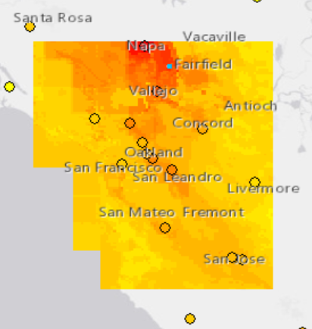
Models on October 13, 2017 (Tubbs Fire)
Two-Stage. Min: -53.8. Max: 395. Median: 34.8. Mean: 39.6. | CatBoost. Min: 8.7. Max: 198. Median: 35.7. Mean: 38.5. | LightGBM. Min: 7.3. Max: 128. Median: 34.1. Mean: 38.5.
PM_{2.5}(µg/m³)
-150 or less
0
+150 or more
-150 or less
0
+150 or more
-150 or less
0
+150 or more

Slide 15
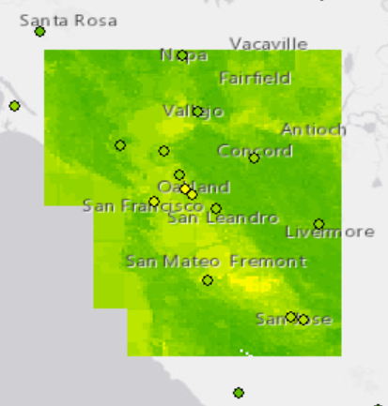
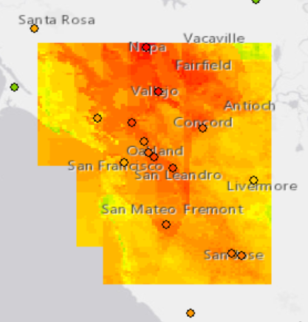
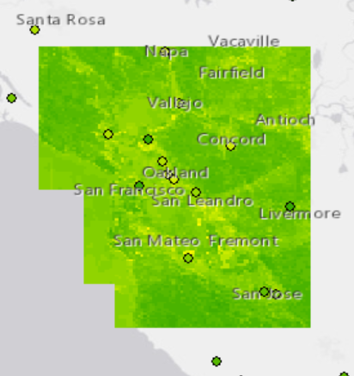
CatBoost Model
(before, during, and after Tubbs Fire)
Before: October 1, 2017 | During: October 13, 2017 | After: October 31, 2017
PM_{2.5}(µg/m³)
0
16
50
200
0
16
50
200
0
16
50
200

Slide 16
Conclusions
Machine learning models perform the best. Certain relationships appear to be strictly non-linear, such as the contribution of point emissions to PM_{2.5} levels.
Machine learning models appear more suited to estimate extreme values. Non-linear models may be better for public health research interested in assessing the effects of a broad range of PM_{2.5} levels in areas without monitors.
The buffer zone around the target area is important. The monitors around the edges of the training area performed worse than those in the middle. This may be an issue for estimating PM_{2.5} adjacent to the coast.

Slide 17
Next steps
More research must be done tuning the different models. The machine learning models show promising preliminary results, but more research must be done to uncover their full potential.
More research must be done on choosing the most pertinent parameters. This study has shown that a broad array of parameters can lead to promising results, but a more careful analysis of which parameters work best together is needed.
The creation of a continuous, 1 km² resolution dataset available to public health researchers. This study suggests that a carefully crafted non-linear model can exhibit the necessary accuracy to be valuable to public health research.

Slide 18
Skills Learned during my NASA/CAARE Internship
Remote sensing fundamentals and applications, including ARSET training
Daily Live Virtual GIS Lessons with ArcGIS
Programming, data processing, and statistical analysis in Python and R
Conducting scientific research and literature review, oral and poster presentations, and technical writing for scientific publication (submission to AGU and JAWMA)
Learned about the work and experiences of other CAARE interns through MSFC/ARC bi-weekly tag-up web conferences
Familiarization with NASA programs and opportunities through OSTEM’s NASA-wide virtual presentations by NASA scientists, engineers and astronauts
Notes:
Caare at both marshall and ames
Journal of Air and Waste management association
What caare stands for
Center for applied atmospheric research and eductaion
Center led by SJSU; collaborative effort...
Funded by NASA minority university research and education program (MEURIP/MIRO program)

Slide 19
Acknowledgements
Thanks to the Center for Applied Atmospheric Research and Education (CAARE), NASA Office of Education’s Minority University Research and Education Project (MUREP) Institutional Research Opportunity (MIRO) Program, NASA/MSFC/Earth Science Office, NASA/MSFC/Academic Affairs Office, and CAARE Director Dr. Sen Chiao from San Jose State University.
A special thank you to mentors Dr. Mohammad Al-Hamdan and Christian White for their timely support, guidance, and encouragement throughout this whole process.
We appreciate the help of CAARE interns Emily Lill and Lucas Cohen, whose input has been invaluable. Their related California air quality research presentations will be today at 2pm and 3pm CT at the OSTEM symposium.
Notes:
Nasa marshall earth science office

Slide 20
References
¹ Delfino, R. J., Brummel, S., Wu, J., Stern, H., Ostro, B., Lipsett, M., Winer, A., Street, D. H., Zhang, L., Tjoa, T., & Gillen, D. L. (2009). The relationship of respiratory and cardiovascular hospital admissions to the southern California wildfires of 2003. Occupational and Environmental Medicine; London, 66(3), 189.
² Westerling, A. L., & Bryant, B. P. (2008). Climate change and wildfire in California. Climatic Change, 87(1), 231–249.
³ Hu, Xuefei, et al. (2014). Estimating Ground-Level PM2.5 Concentrations in the Southeastern United States Using MAIAC AOD Retrievals and a Two-Stage Model. Remote Sensing of Environment, vol. 140, pp. 220–232., doi:10.1016/j.rse.2013.08.032.
⁴ Zamani Joharestani, M.; Cao, C.; Ni, X.; Bashir, B.; Talebiesfandarani, S. (2019). PM_{2.5} Prediction Based on Random Forest, XGBoost, and Deep Learning Using Multisource Remote Sensing Data. Atmosphere, 10, 373.
⁵ Stowell, Jennifer D, et al. (2020). Estimating PM2.5 in Southern California Using Satellite Data: Factors That Affect Model Performance. Environmental Research Letters, doi:10.1088/1748-9326/ab9334.
⁶ Al-Hamdan, Mohammad Z., et al.(2009). Methods for Characterizing Fine Particulate Matter Using Ground Observations and Remotely Sensed Data: Potential Use for Environmental Public Health Surveillance. Journal of the Air & Waste Management Association, vol. 59, no. 7, pp. 865–881., doi:10.3155/1047-3289.59.7.865.
⁷ Gupta, P., Doraiswamy, P., Levy, R., Pikelnaya, O., Maibach, J., Feenstra, B., et al. (2018). Impact of California fires on local and regional air quality: The role of a low-cost sensor network and satellite observations. GeoHealth, 2, 172–181. https://doi.org/10.1029/2018GH000136

Slide 21
Q&A
My contact information:
Email: annaboser@ucsb.edu
Website: https://anna-boser.github.io/Website/
Learn more about the CAARE program:
Website: www.sjsu.edu/caare

Slide 22
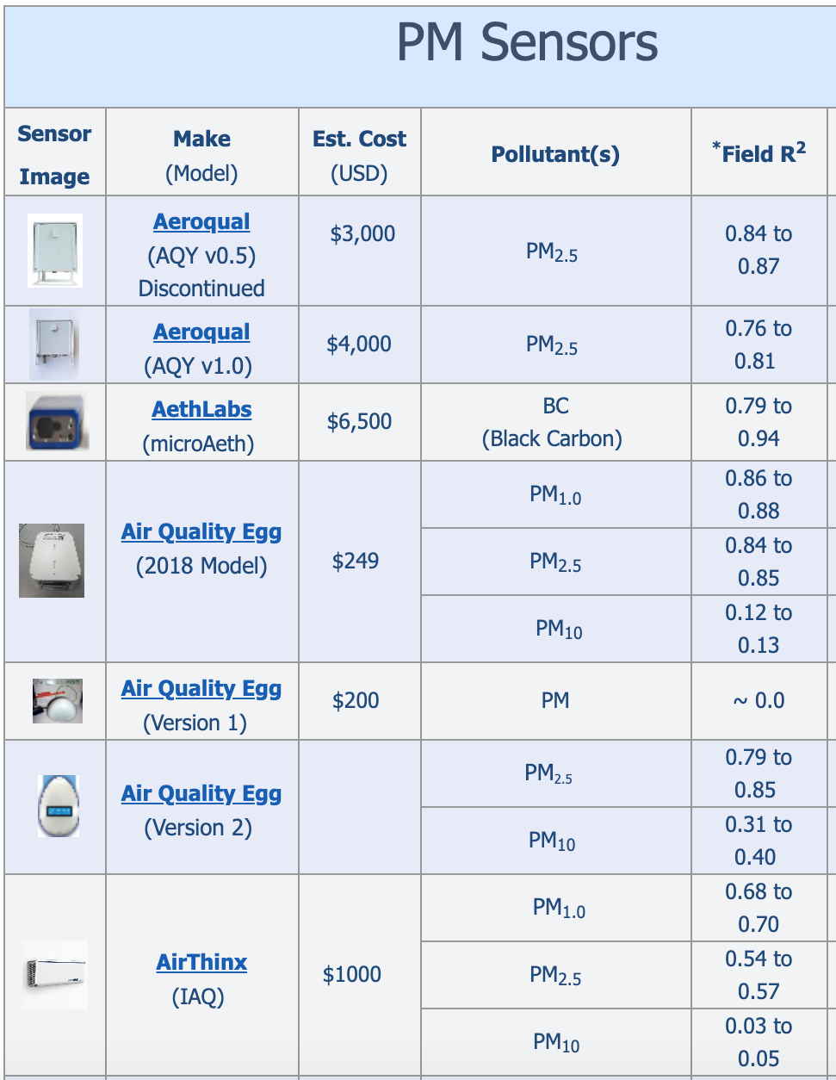
Low Cost Air Quality Sensors
According to the South Coast Air Quality Management District’s (AQMD) Air Quality Sensor Performance Evaluation Center (AQ-SPEC), the accuracy of the best models rivals that of the best low cost air quality sensors (LCAQS)
More information can be found at: http://www.aqmd.gov/aq-spec/evaluations

